Slide 1

THE PORTAGE APL

Slide 2
TABLE OF CONTENTS
BIG IDEA
DASHBOARD
FUTURE PREDICTIONS
SUGGESTIONS

Slide 3
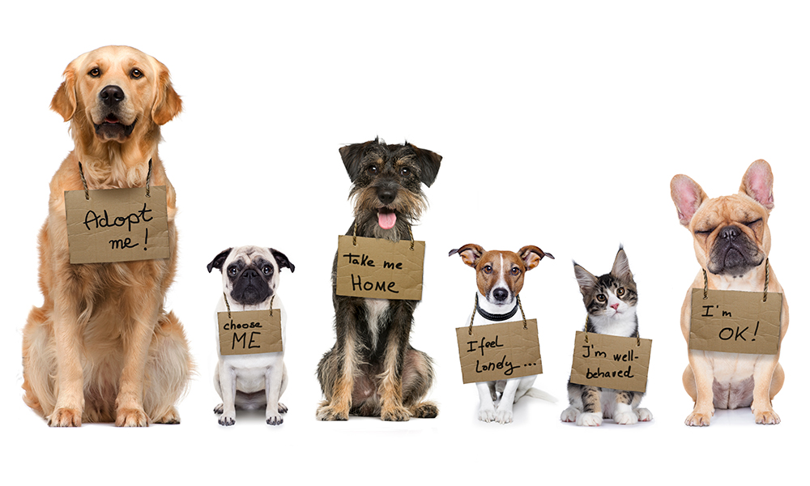
BIG IDEA
Empowering The Portage APL through targeted action: The dashboard provides insights on where to focus resources and which category of animals need the most attention.

Slide 4
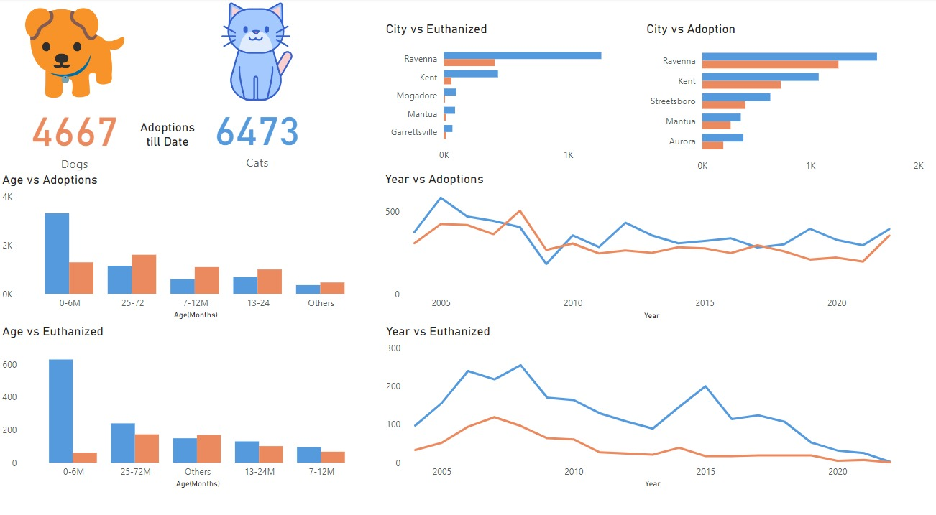
Saving LIVES:USING DATA TO IMPROVE ANIMAL CARE

Slide 5
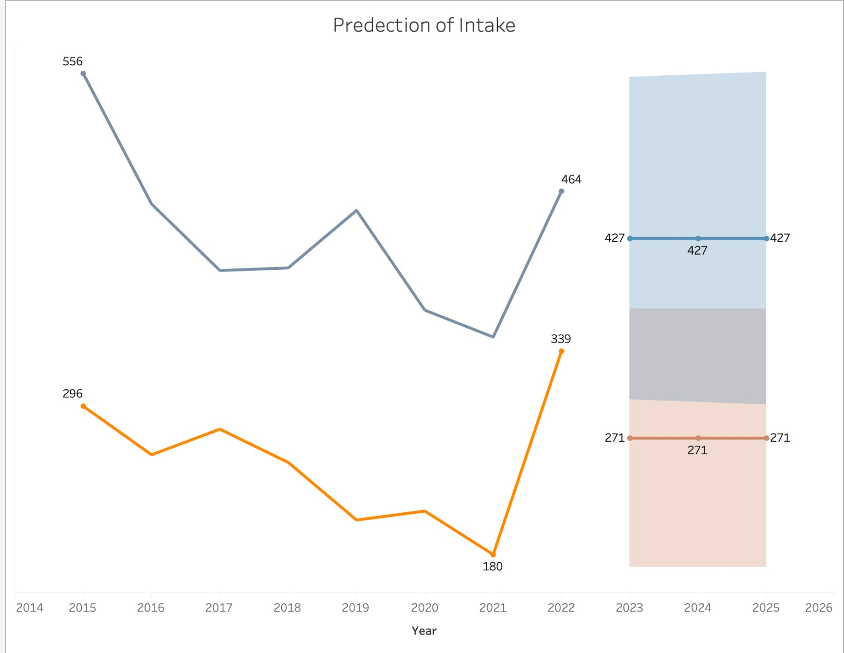
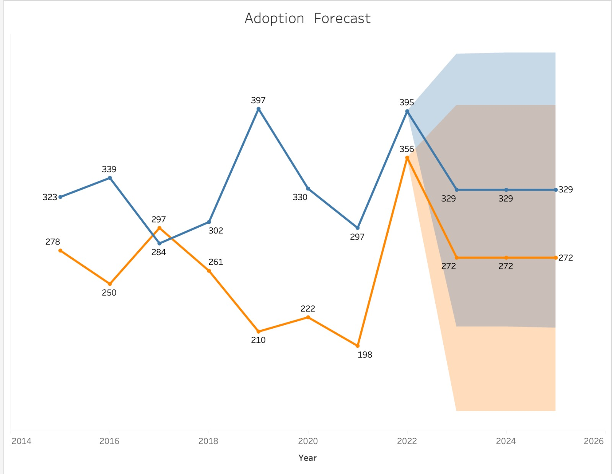
FUTURE PREDICTIONS

Slide 6
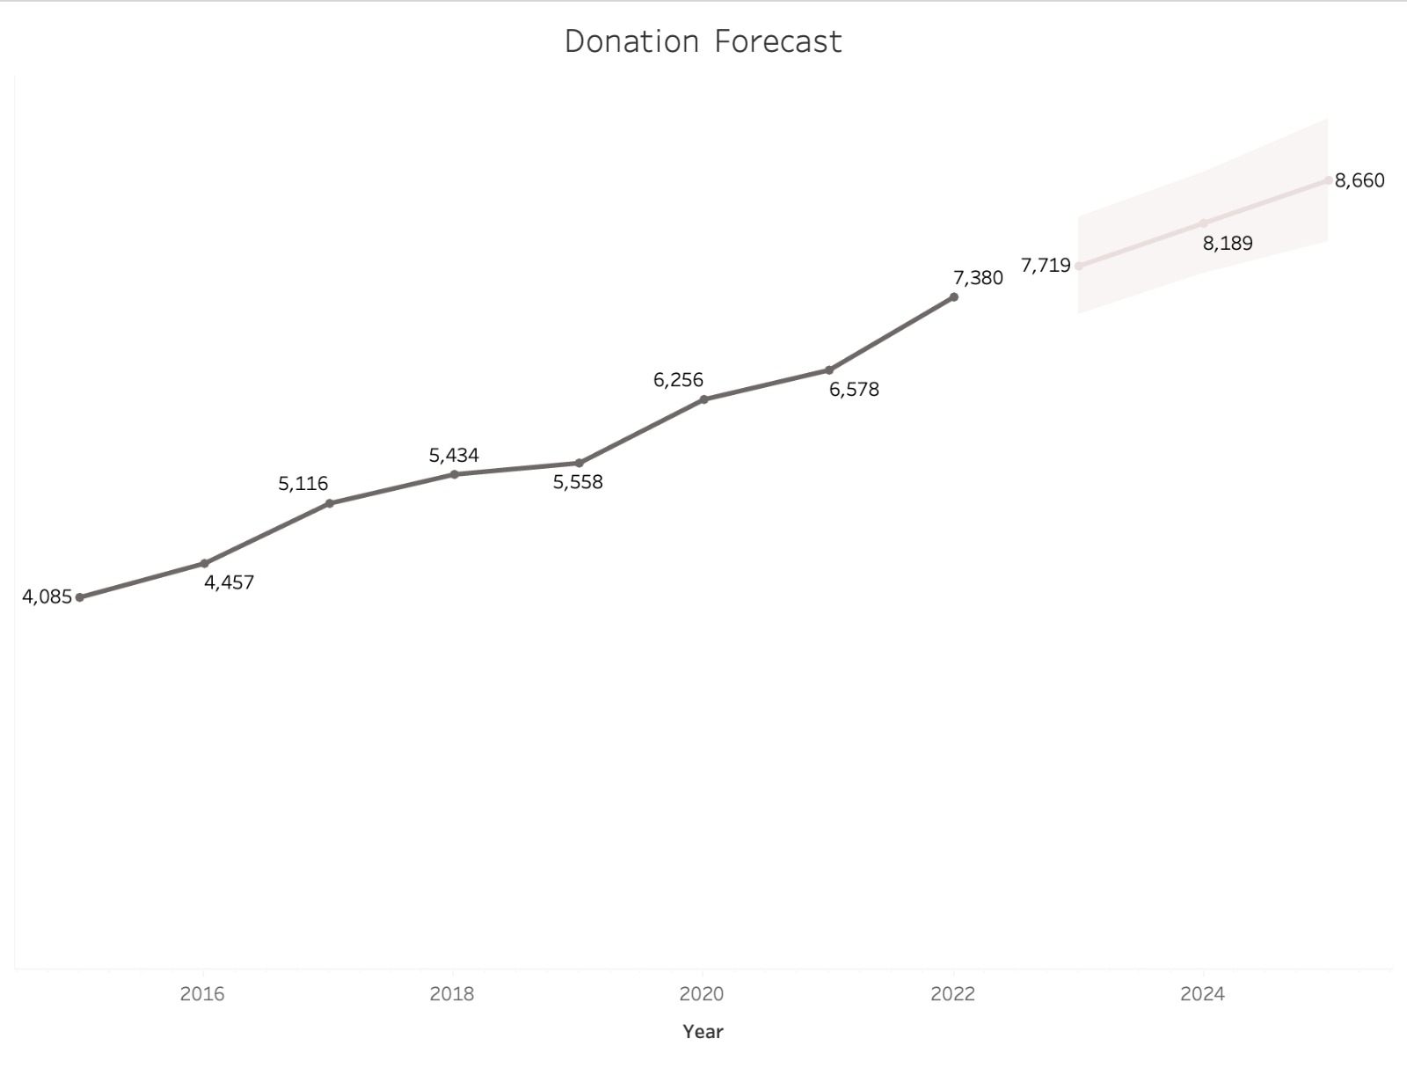

Slide 7
SUGGESTIONS
Perform a background check of individuals.
Collect data on events and their performance.
Collect data related to expenses per animal.
Record the date when a donation is made.

Slide 8


